Slide 1
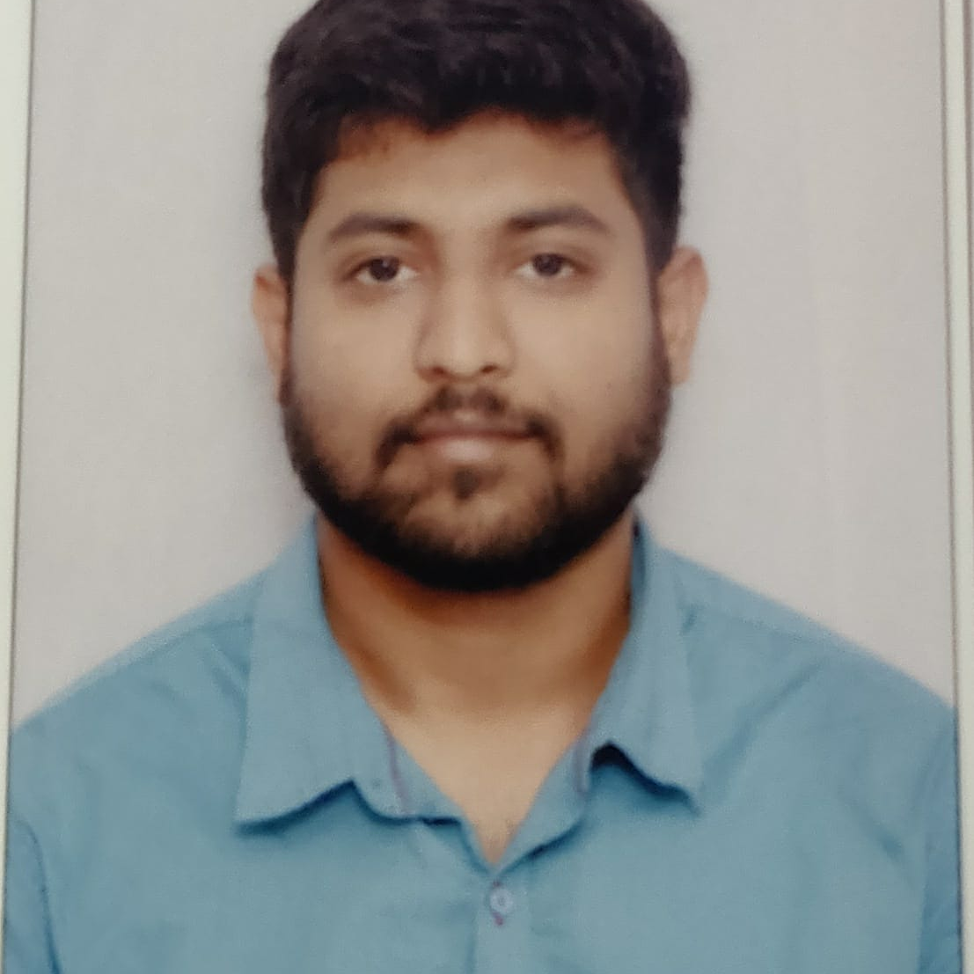

AZMEERA SRAVAN
Analyst/Software Engineer
Bachelor of Technology
Mechanical Engineering: 2017 - 2021
Skills C#
Java
.NET Entity Framework
Database
SQL database – MySQL
Web Technologies
HTML
ASP.NET MVC
Web API
Console application
Add-ons
GitHub
Postman
Additional Details
Leadership
Excellent Communication Skills
Team management
Quick Learner
Bangalore
Azmeera.sravan@capgemini.com
+91 9154899771
A4
Software Engineer who is Strong in design and integration with intuitive problem-solving skills. Passionate about implementing and launching new projects.
Ready to learn new technologies and implement them to further improve my knowledge.
Eager to work in a team of dedicated people and serve a key role in the enhancement and development of the project.
Has working knowledge of C#, SQL, Entity Framework, ASP.NET in visual studio, and Java on an intermediate level.
GIG MANAGEMENT SYSTEM
To develop a user interface for the GIG Management system. This is a mini social network that makes it really easy for live music lovers to track the gigs of their favorite artists.
C#,SQL,ASP.NET MVC,ASP.NET CORE API, ENTITY FRAMEWORK, CONSOLE APPLICATION in visual studio.
Learned and completed all the concepts of Frontend, Middleware, and Backend at Capgemini L&D Training Platform.

